Slide 2
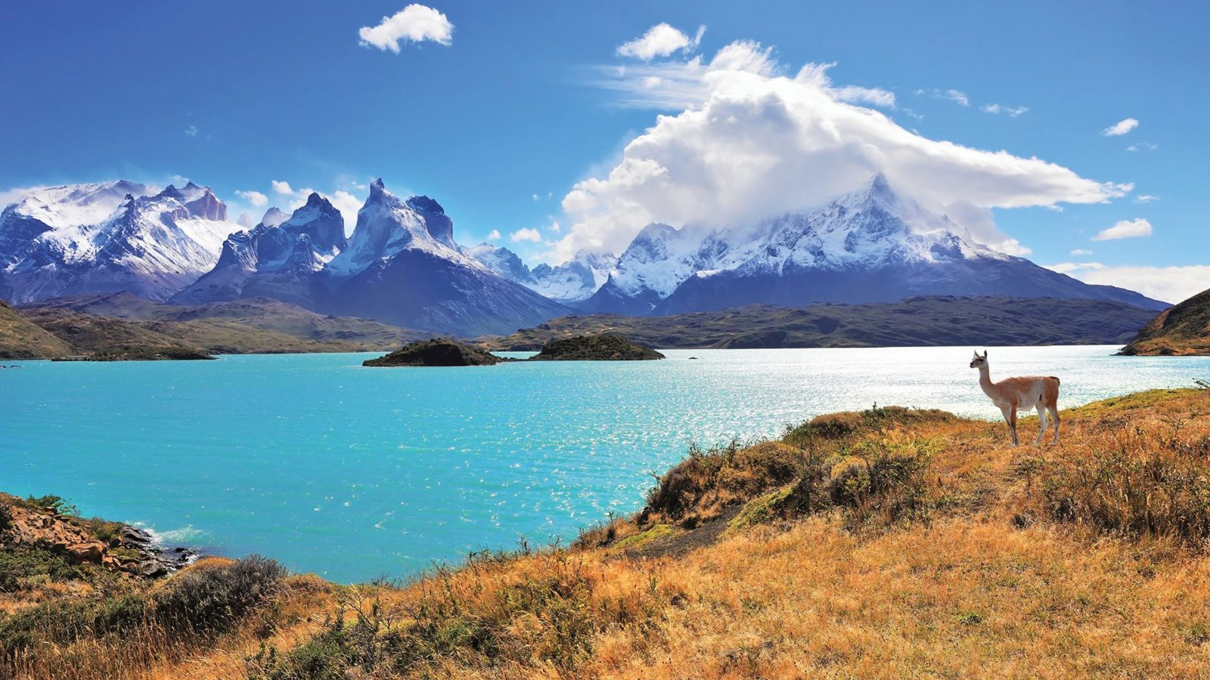
Unidad 3: The Natural World
6° Básico

Slide 3
TODAY WE ARE GOING TO LEARN ABOUT
ANIMALS
HABITATS
REGULAR VS. IRREGULAR PLURAL NOUNS

Slide 4
ANIMALS
What is your favorite animal?

Slide 5
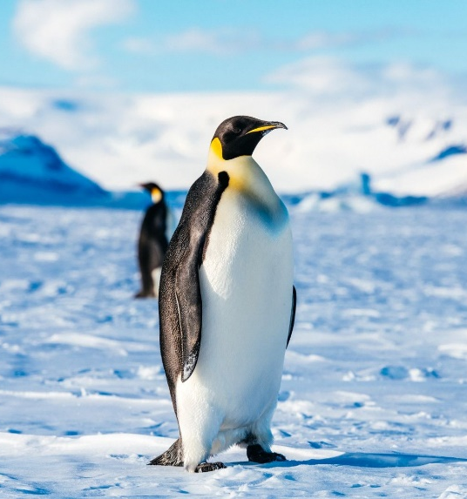
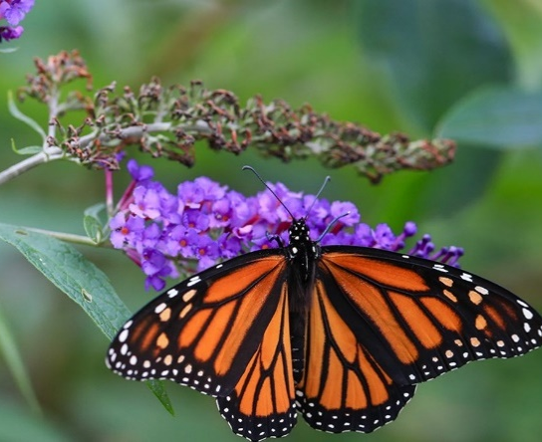
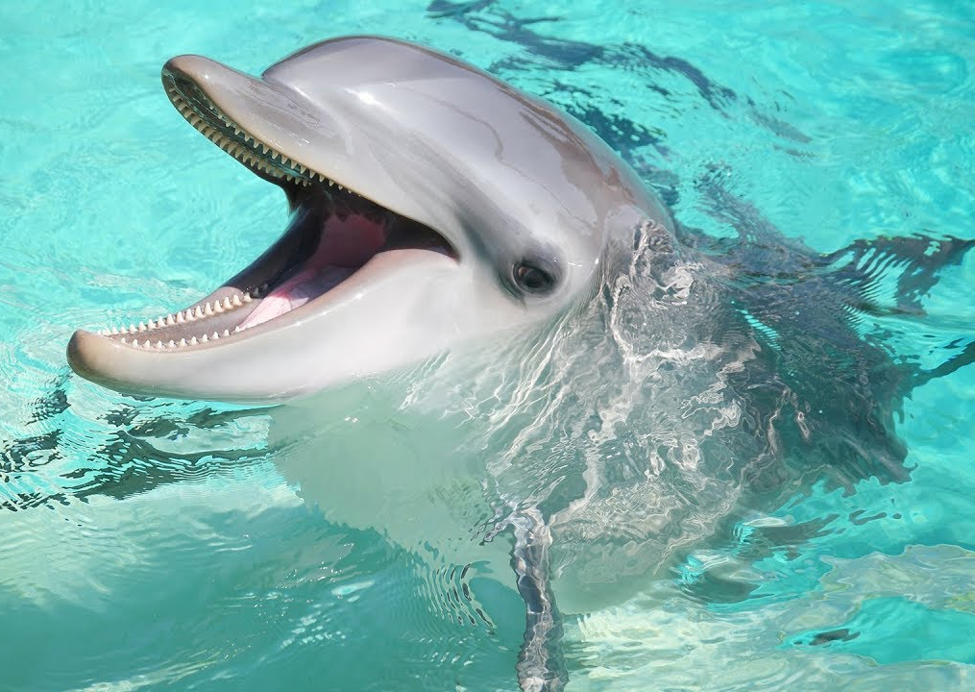
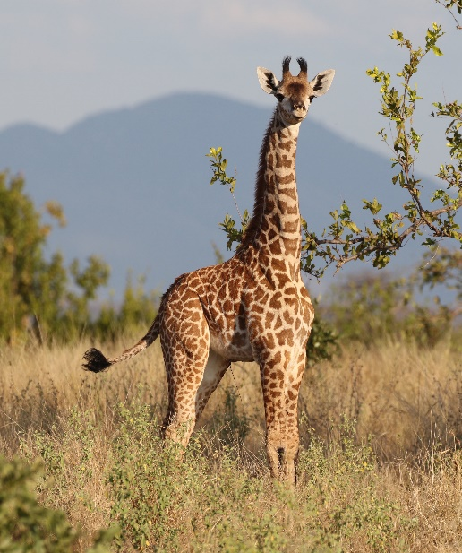
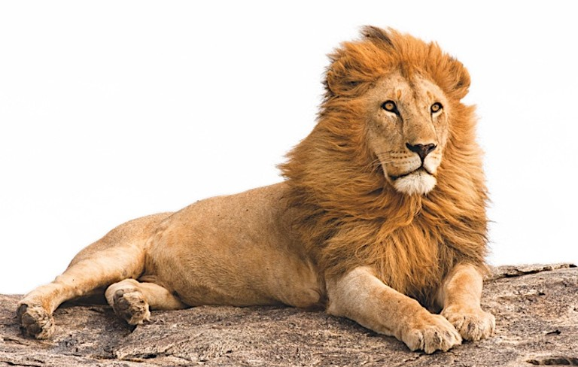
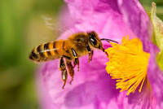
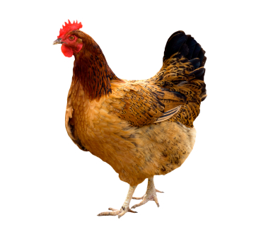
LION
ELEPHANT
FOX
SNAKE
GIRAFFE
GOAT
PARROT
WHALE
SHARK
WOLF
PENGUIN
HEN
FROG
MONKEY
BEAR
BUTTERFLY
BEE
CAMEL
DUCK
HIPPO
COW
SEAL
DOLPHIN

Slide 6
HABITATS
Where do they live?

Slide 7
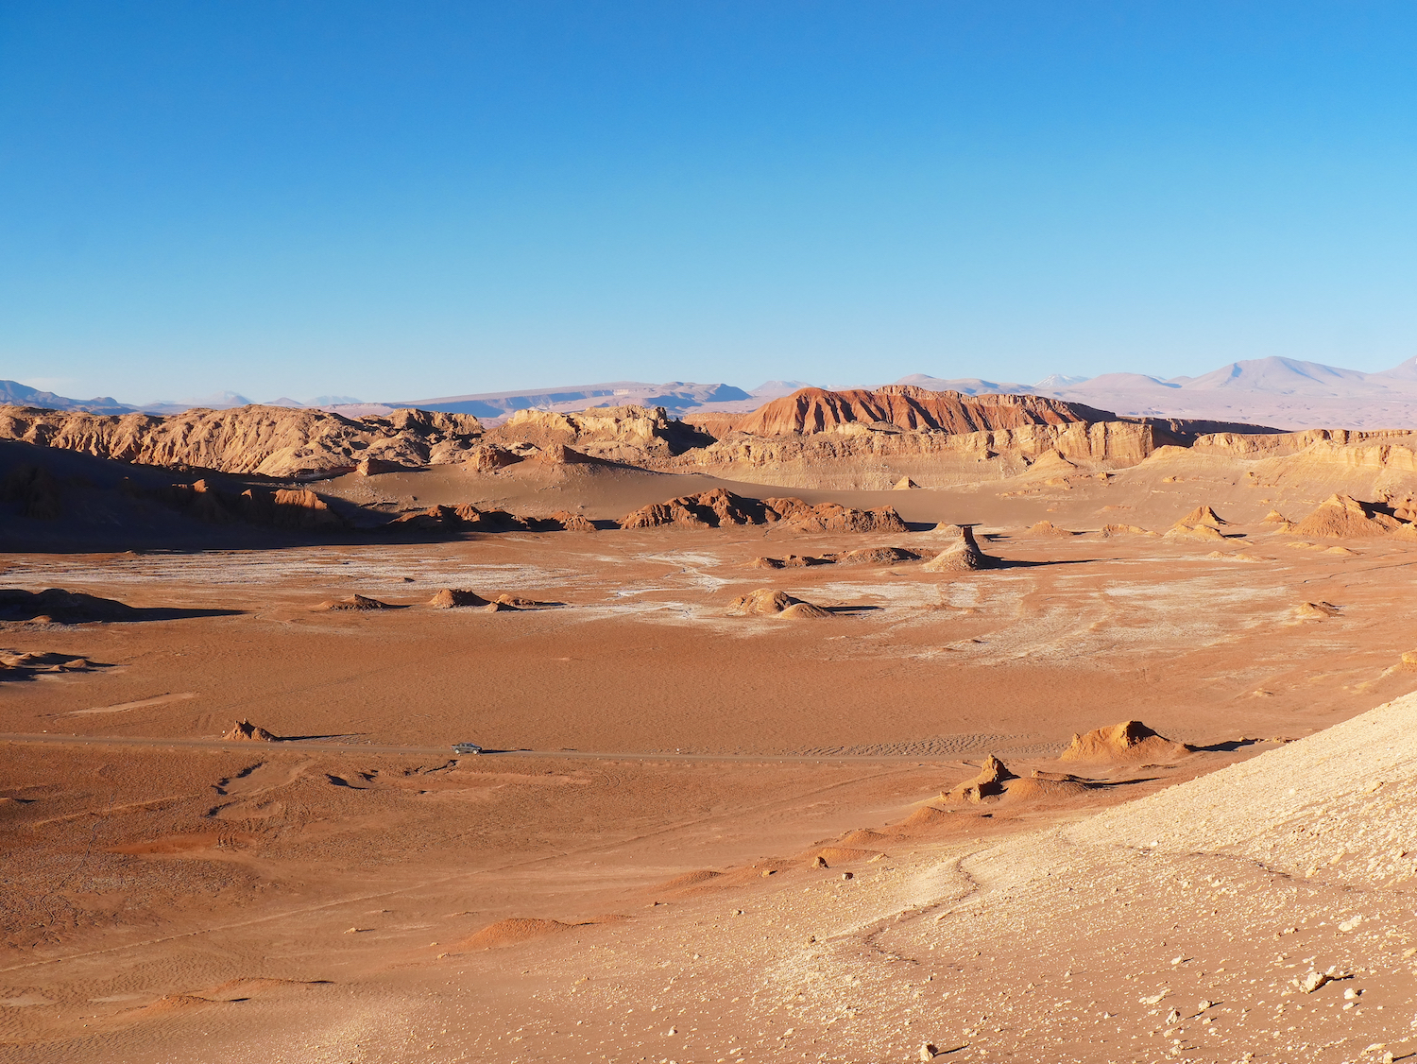
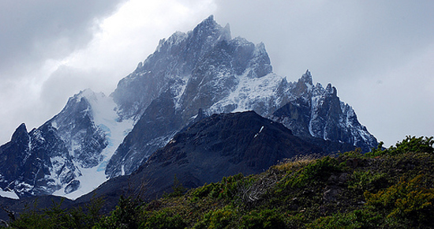
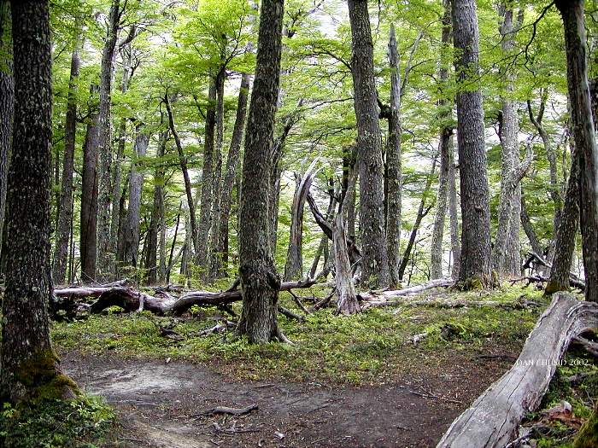
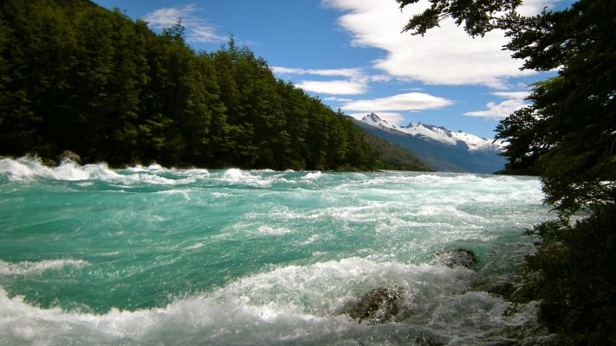
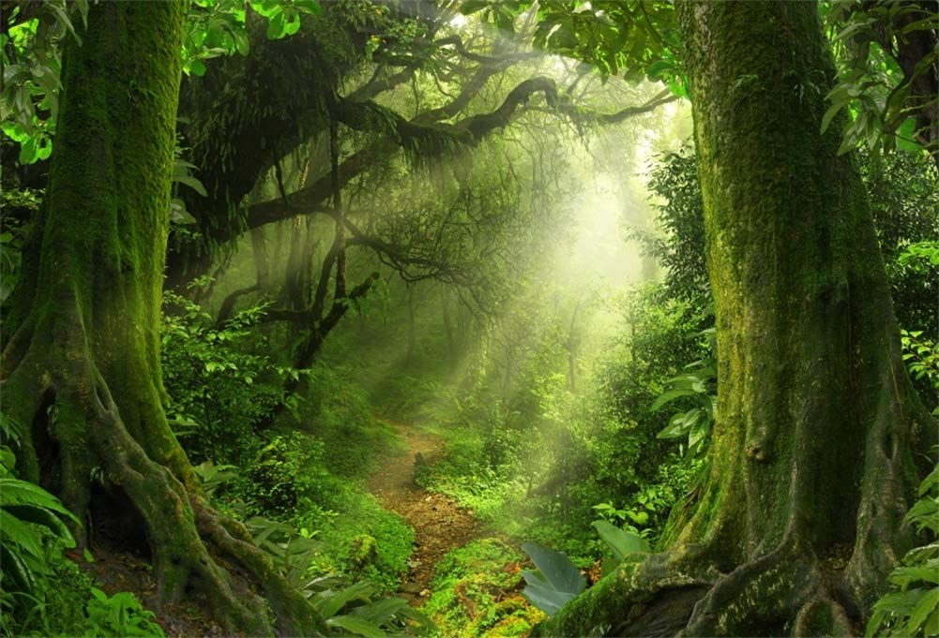
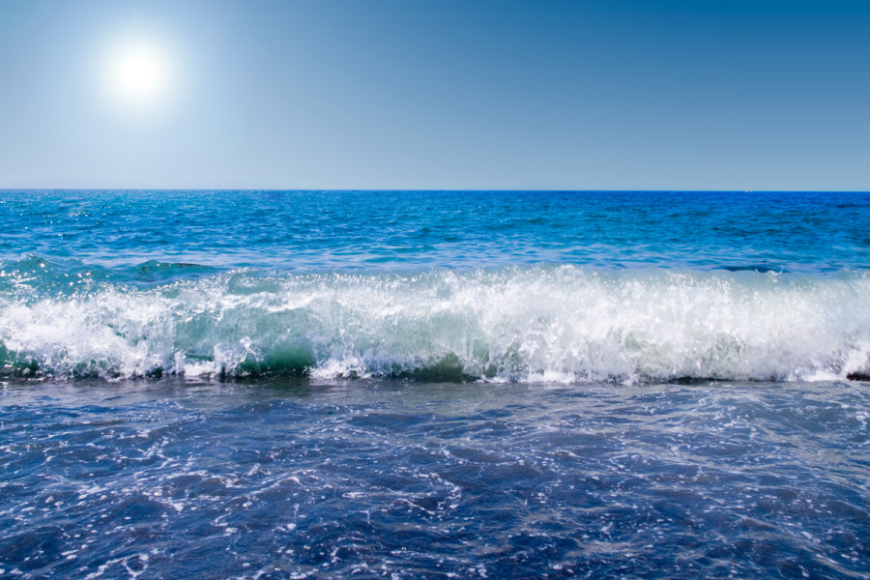
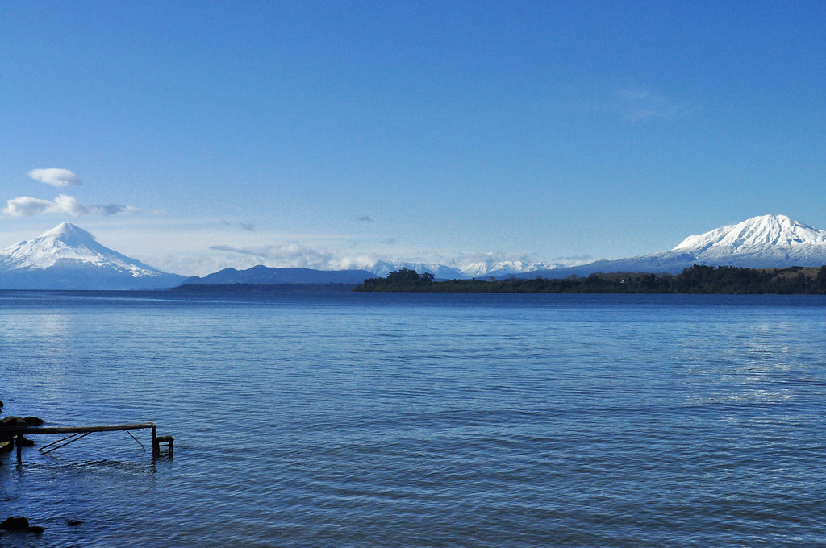
FOREST
MOUNTAINS
JUNGLE
SEA
RIVER
LAKE
DESERT

Slide 8
SINGULAR VS. PLURAL NOUNS

Slide 9
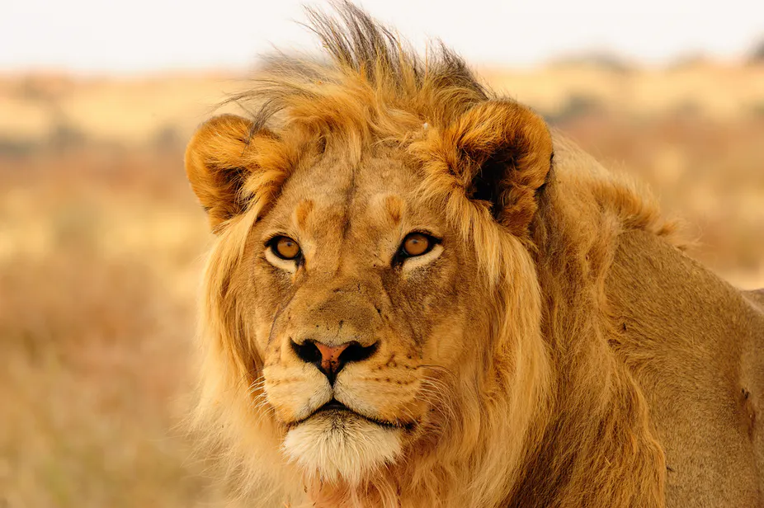
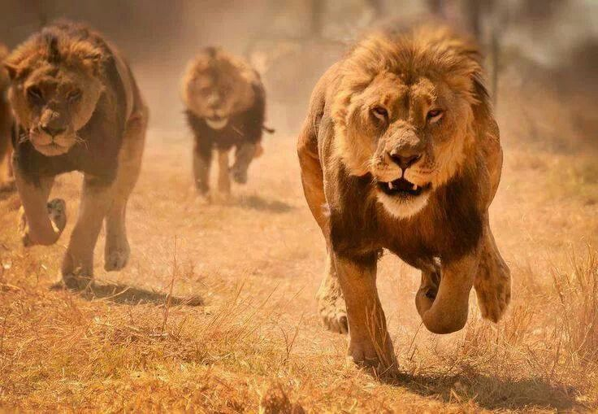
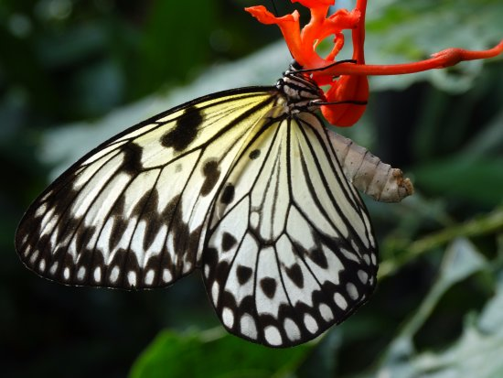
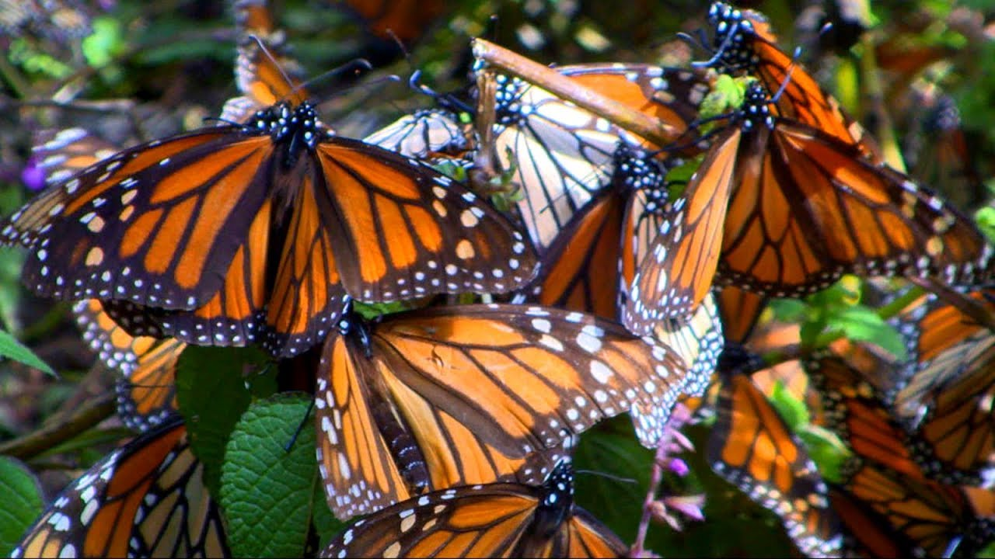
SINGULAR (1)
LION
FOX
WOLF
BUTTERFLY
PLURAL (+1)
LION-S
FOX-ES
WOL-VES
BUTTERFL-IES

Slide 10
REGULAR VS. IRREGULAR PLURAL NOUNS

Slide 11
PLURAL NOUNS
REGULAR
IRREGULAR
DOG-S
TURTLE-S
MONKEY-S
WOLF WOLVES
SHEEP SHEEP
MOUSE MICE

